Slide 1
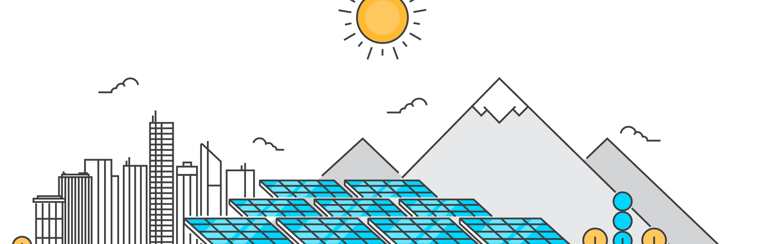
ENERGY SOURCES IN SPAIN
Jesús Almansa, 2022

Slide 2
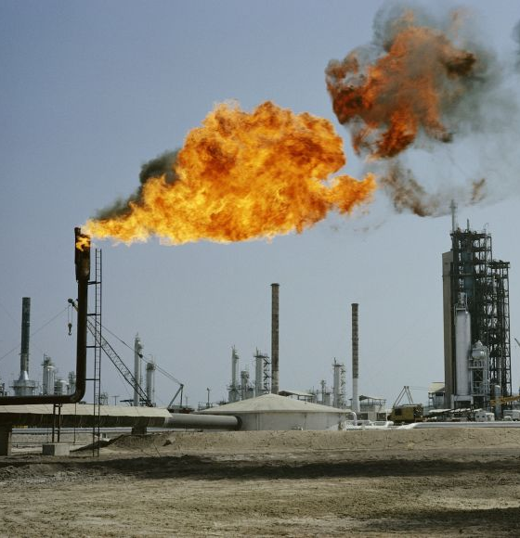
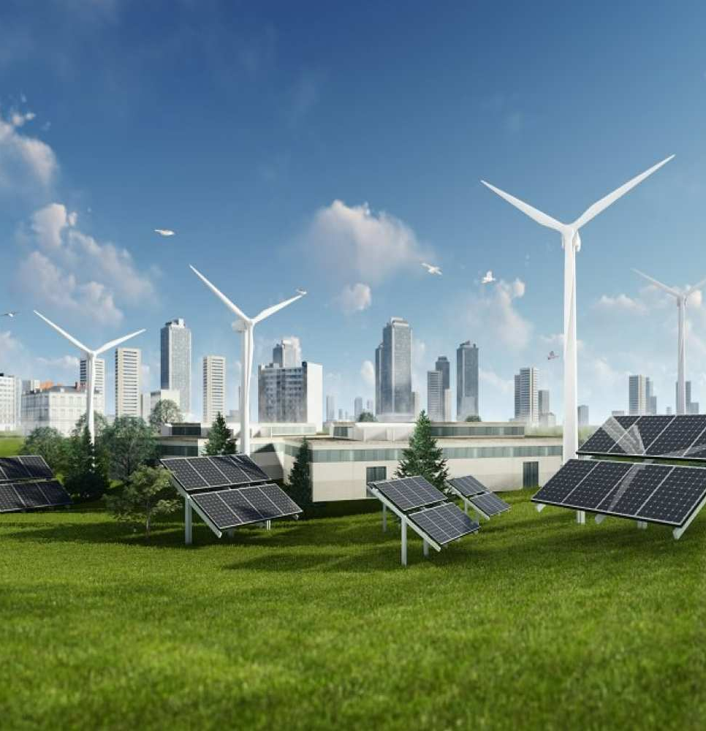

Slide 3
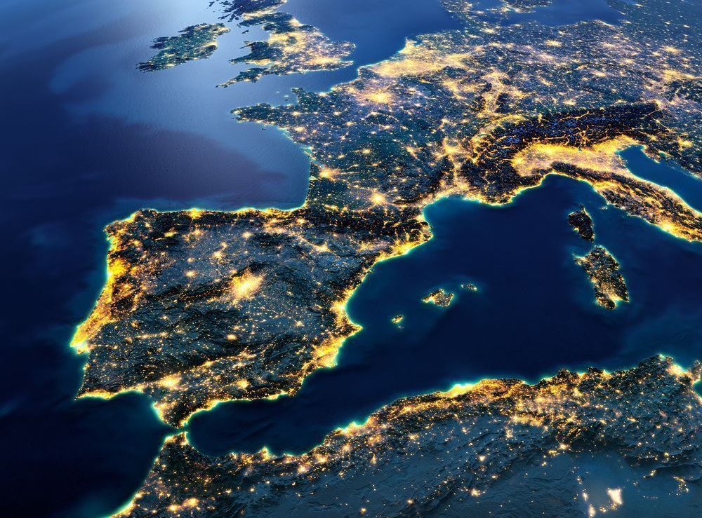


Slide 4
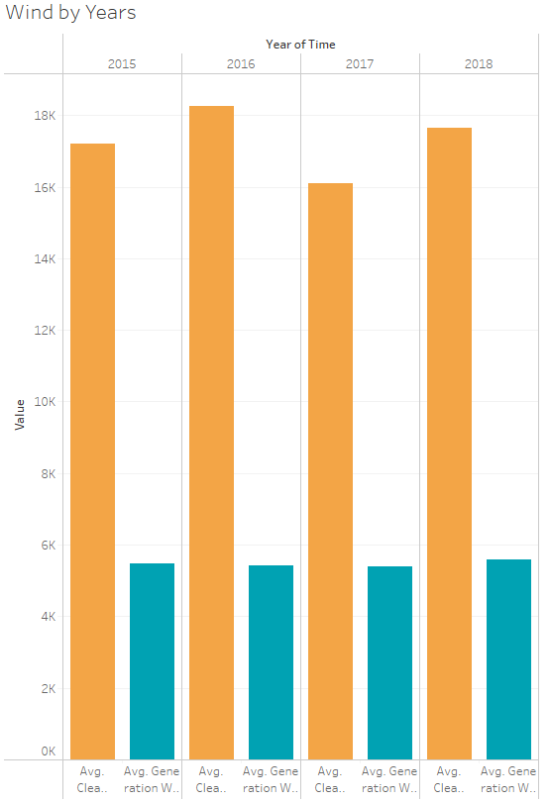
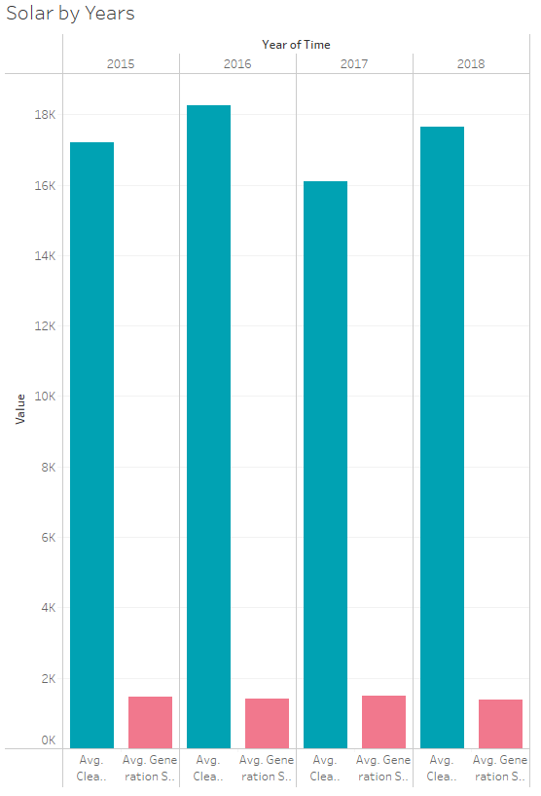

Slide 5
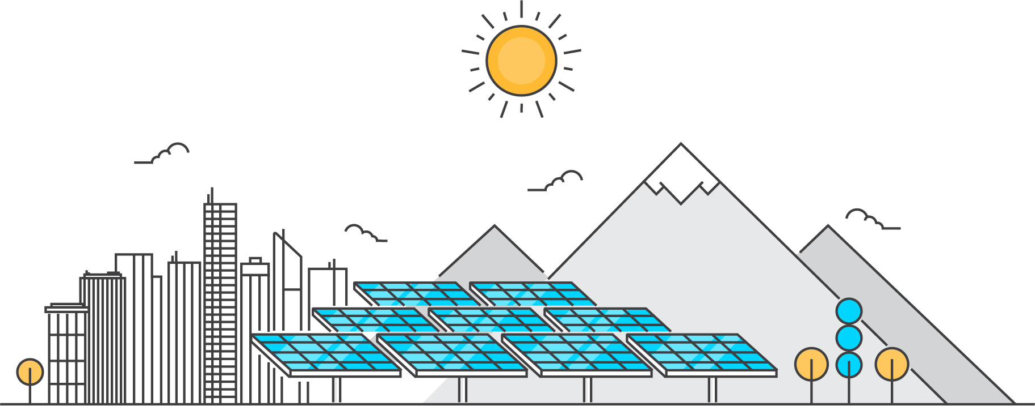
THE CHANCE
Can Spain be energetically independent thanks to renewable energies?

Slide 6
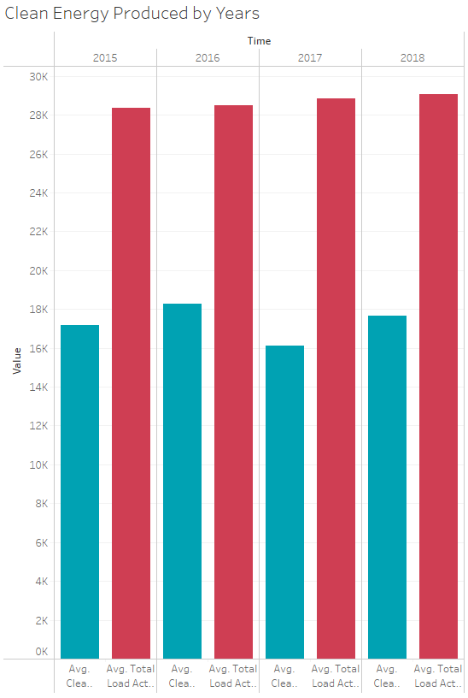
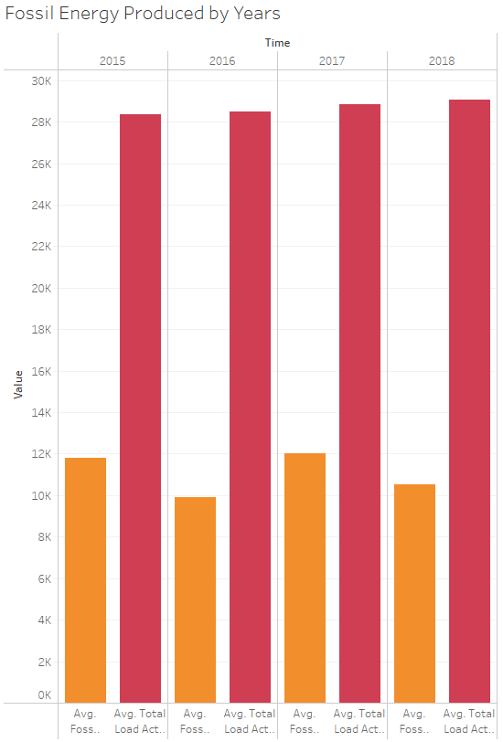

Slide 7
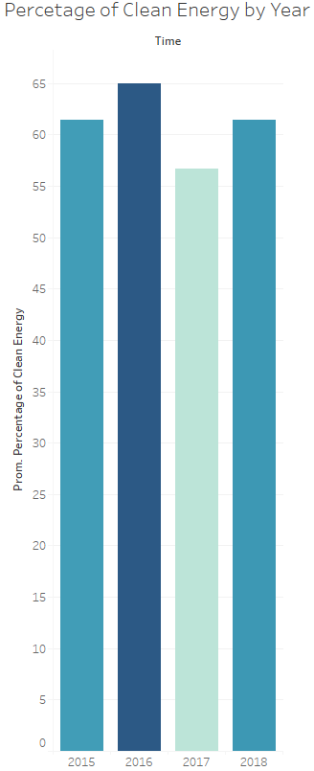
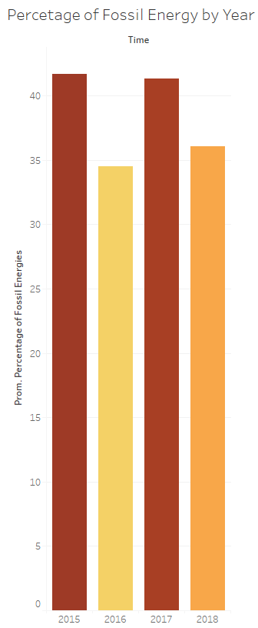

Slide 8
THE OPPORTUNITY
Is it cheaper to produce and consume clean energy rather than fossil?

Slide 9
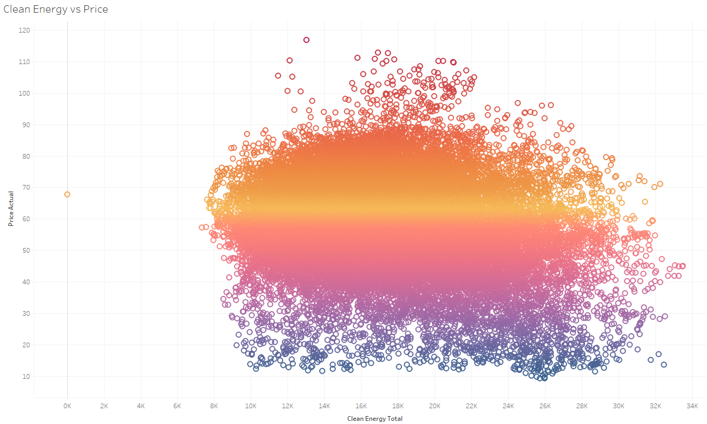

Slide 10


Slide 11
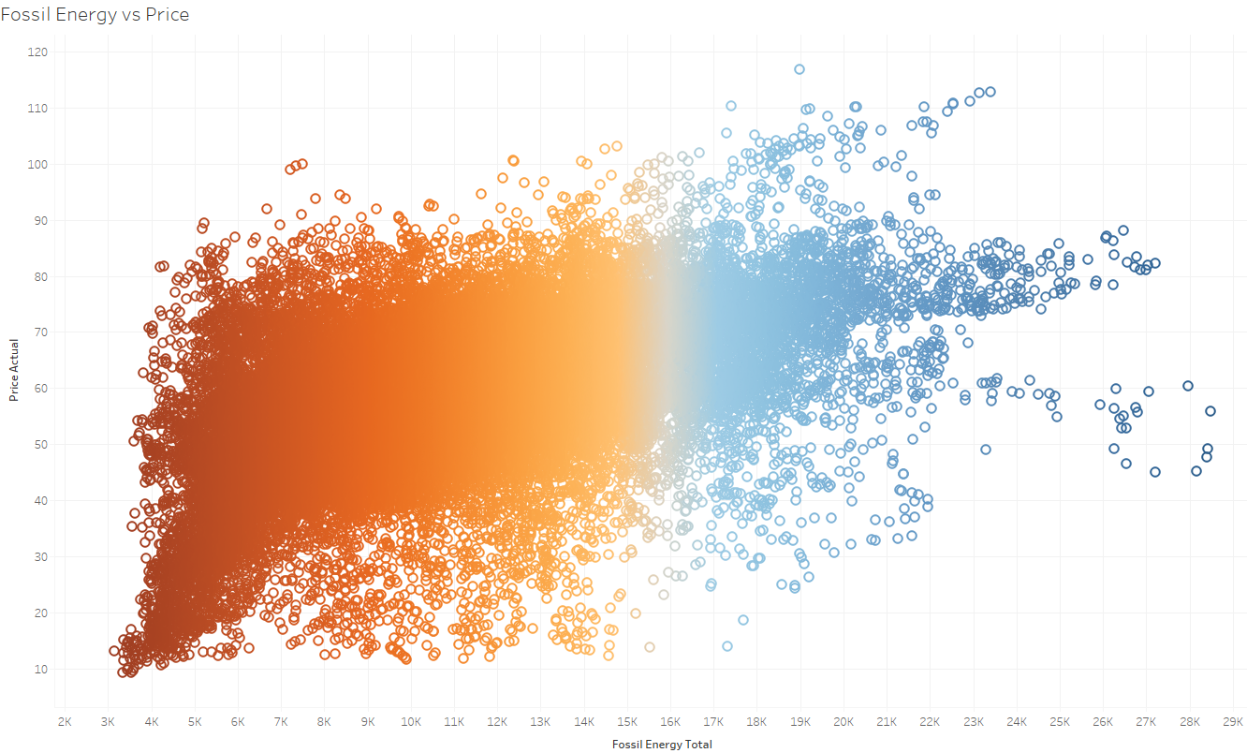

Slide 12
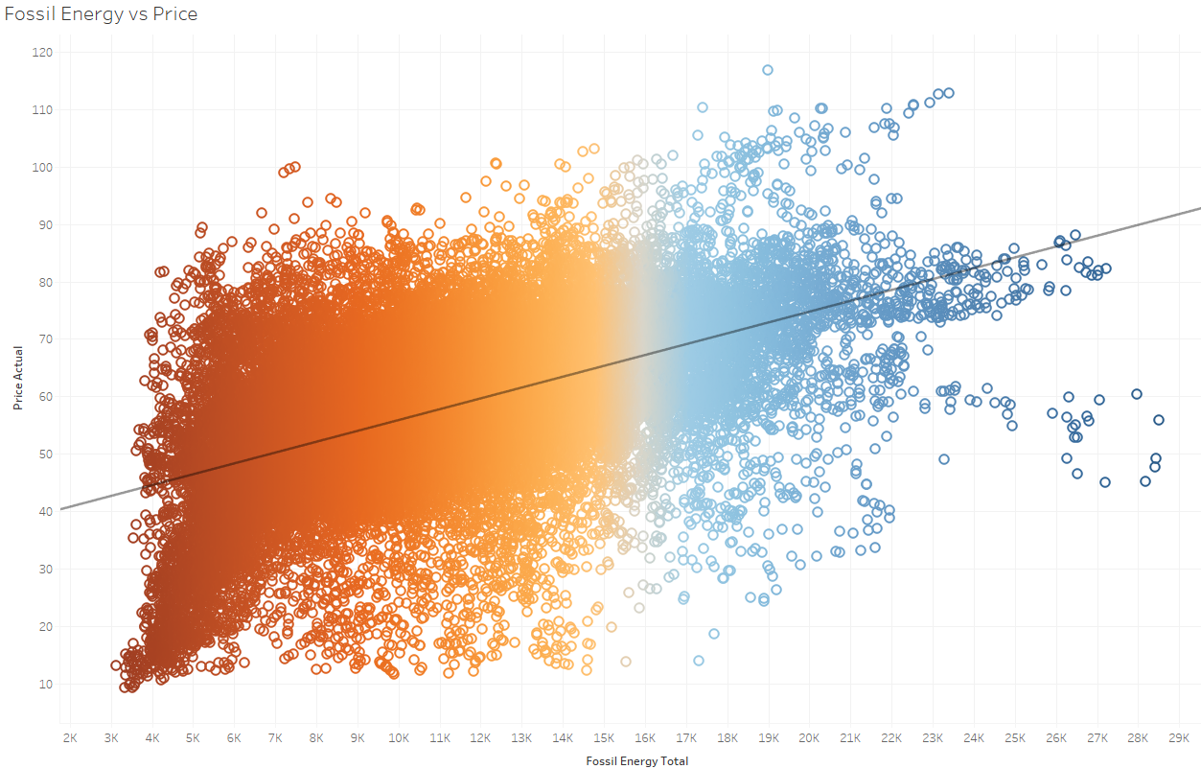

Slide 13


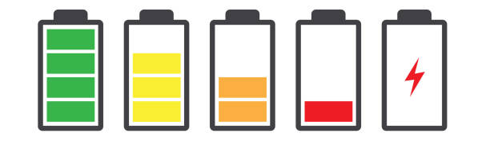
ADVANTAGES
DISADVANTAGES
Infinite energy supply
Zero carbon emissions
Cleaner air and water
Cheaper energy
HIGHER CAPITAL INVESTMENTS
ELECTRICITY PRODUCTION CAN BE UNRELIABLE
RELIABLE ENERGY STORAGE IS STILL IN DEVELOPMENT

Slide 14
THE CHALLENGE

Slide 15
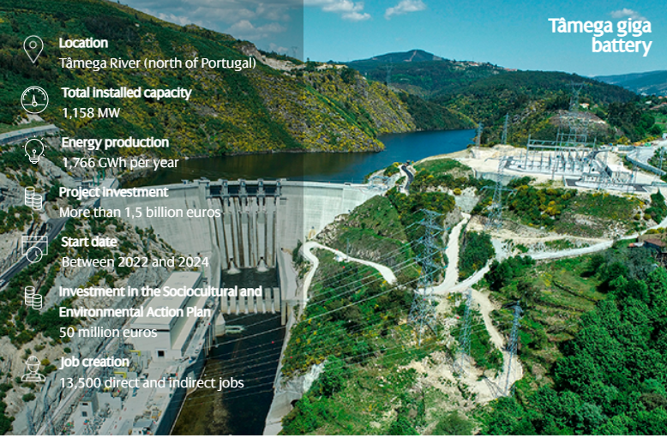

Slide 16

CONCLUSIONS
Data collection needs to be improved
Solar generation has the potential to be a great source of energy
Nuclear energy is the future of energy production and sustainability
Clean energy is the path if we want to keep living on Earth

Slide 17
FULL RESEARCH AND PROJECT AT GITHUB
Github.com/SangreNocturna/Energy-Project
THANKS FOR YOUR ATTENTION!

